Slide 1
Microservices from zero to hero
Notes:
Before starting this presentation I would like to highlight the fact this presentation is technology agnostic.
Due to the fact that during the last year I learned this aspects from different perspectives (.NET/.NET Core/Java/PHP) I would prefer to share something from my experience without making technology specific this.
So let’s go deeper with those aspects in our mind.

Slide 2
agenda
About Centric
“Italian” Architecture and Microservices ☺
Onion and Spring
What Is a Microservice?
Building Monolithic Applications
Marching Toward Monolithic Hell
Microservices – Tackling the Complexity
The Benefits of Microservices
The Drawbacks of Microservices
Why Microservices?
Demo
About Centric Internship
Summary
Bibliography

Slide 3
About Centric

Slide 4
About Centric
It is a Dutch company
Notes:
Started in 1992.

Slide 5
About Centric
It is a Dutch company
Portfolio

Slide 6
About Centric
It is a Dutch company
Portfolio
Software solutions
Notes:
Retail
Housing and healthcare
Public sector
Financial
Safety domains

Slide 7
About Centric
It is a Dutch company
Portfolio
Software solutions
IT Outsourcing

Slide 8
About Centric
It is a Dutch company
Portfolio
Software solutions
IT Outsourcing
Business process outsourcing

Slide 9
About Centric
It is a Dutch company
Portfolio
Software solutions
IT Outsourcing
Business process outsourcing
Staffing services

Slide 10
About Centric
It is a Dutch company
Portfolio
Software solutions
IT Outsourcing
Business process outsourcing
Staffing services
Geographic Area

Slide 11
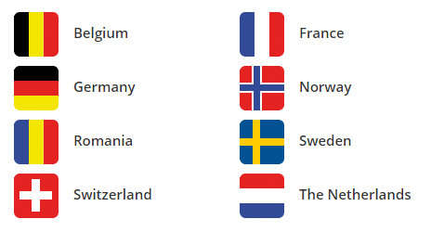
About Centric
It is a Dutch company
Portfolio
Software solutions
IT Outsourcing
Business process outsourcing
Staffing services
Geographic Area
Notes:
Over 5000 employees
Romania : development area=> Development(.NET/Java), Testing, Mobile, AR/VR, UX/Hosting => ~ 250 employees (.NET => 180; Java => 10; AR/VR => 5; Testing => 40; DBA’s Big Data=> 5; Staffing : 10)

Slide 12
“Italian” architecture and Microservices ☺

Slide 13

“Italian” architecture and Microservices ☺
Notes:
A bad architecture looks like spaghetti.

Slide 14

“Italian” architecture and Microservices ☺
Notes:
A good architecture looks like lasagna.

Slide 15

“Italian” architecture and Microservices ☺
Notes:
A microservices architecture should look like: ravioli. ☺
Each raviolo(singular for ravioli) is a self-contain package of Italian food.
- maintain high cohesion and low coupling
- we can swap one raviolo without disrupting the internal content of another ravioli

Slide 16
Onion and Spring
Notes:
After Layered and Hexagonal architectures, the time has come to talk about their close cousin – the Onion Architecture initially introduced in a series of posts by Jeffrey Palermo.
As we said in the introduction, the concept of Onion Architecture is closely connected to two other architectural styles – Layered and Hexagonal.
Similarly to the Layered approach, Onion Architecture uses the concept of layers, but they are a little different:

Slide 17
Onion and Spring
Domain Model layer, where our entities and classes closely related to them e.g. value objects reside

Slide 18
Onion and Spring
Domain Model layer, where our entities and classes closely related to them e.g. value objects reside
Domain Services layer, where domain-defined processes reside

Slide 19
Onion and Spring
Domain Model layer, where our entities and classes closely related to them e.g. value objects reside
Domain Services layer, where domain-defined processes reside
Application Services layer, where application-specific logic i.e. our use cases reside

Slide 20
Onion and Spring
Domain Model layer, where our entities and classes closely related to them e.g. value objects reside
Domain Services layer, where domain-defined processes reside
Application Services layer, where application-specific logic i.e. our use cases reside
Outer layer, which keeps peripheral concerns like UI, databases or tests

Slide 21
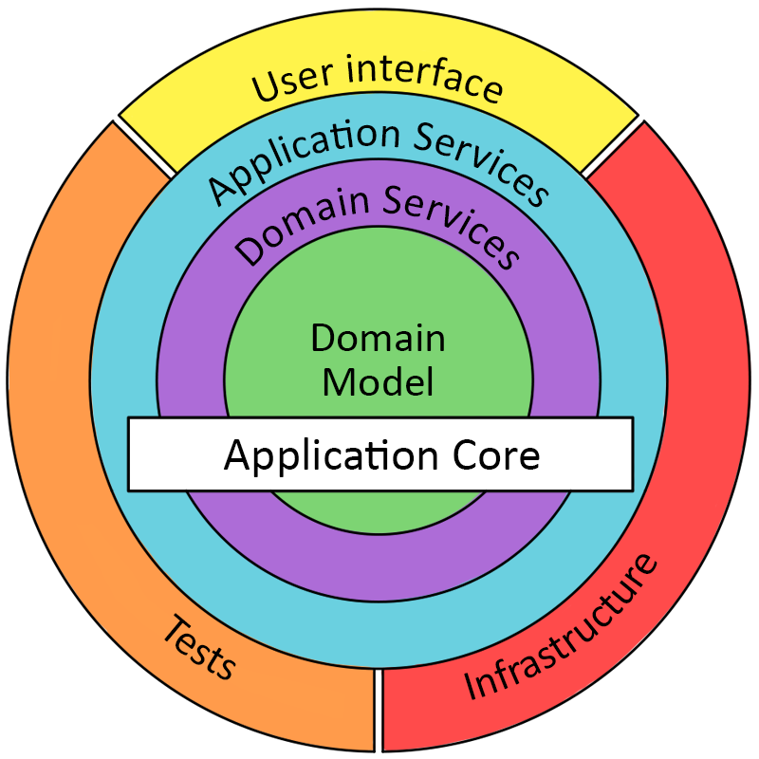
Onion and Spring
Notes:
Between the layers of the Onion, there is a strong dependency rule: outer layers can depend on lower layers, but no code in the lower layer can depend directly on any code in the outer layer.

Slide 22
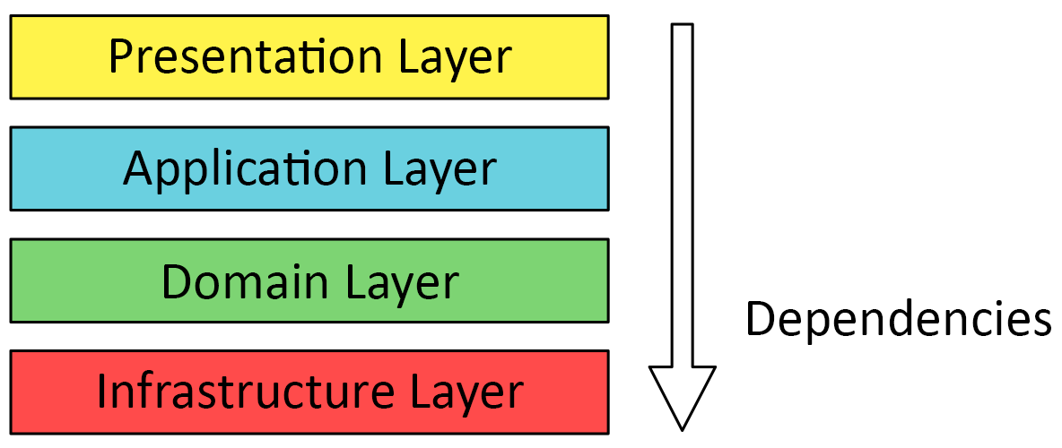
Onion and Spring
Notes:
The application core should NOT depend on the infrastructure: what if the database solution changes? This architecture violates the previous rule: the core should not change, regardless of the infrastructure implementation

Slide 23
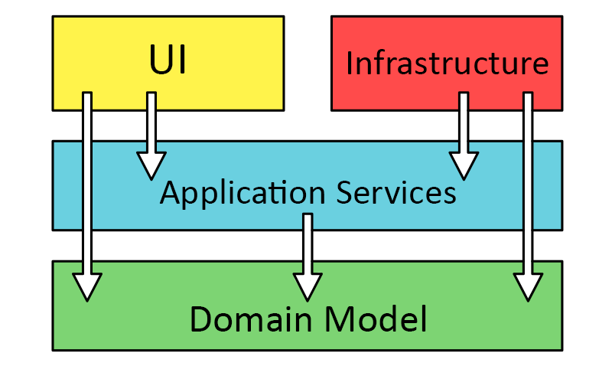
Onion and Spring
Notes:
The proper way: the Domain Model is the Core, and is not dependent on anything else

Slide 24
What Is a Microservice?
Notes:
Before starting any debate/discussion related to microservices I’m having a question:
Do you know when this theory started?
Let’s have a look to a google statistic in regards with this matter.
2011 =>

Slide 25
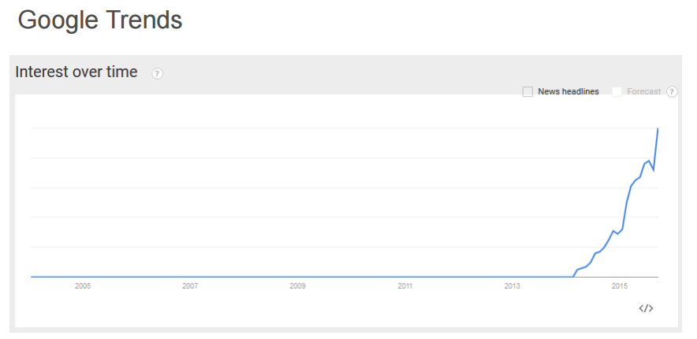
What Is a Microservice?
Notes:
As we can see from this chart that the discussions, saying this, with other words the “interest”, became more visible since 2014.
Since than, after some remarkable presentations held by Martin Fowler the interest for microservices increased.
Talking about a definition:
1st one :

Slide 26
What Is a Microservice?
“Microservices are a thing these days.”
Phil Calçado, former Director of Engineering, SoundCloud
Notes:
Microservices are “fashionable” these days. However, for renowned companies with incredibly complex products (Amazon – AWS, Netflix, etc.), they are not only fashion, they are a requirement.

Slide 27
What Is a Microservice?
“Microservices are small, autonomous services that work together.”
Sam Newman, Thoughtworks

Slide 28
What Is a Microservice?
“Loosely coupled service-oriented architecture with bounded contexts.”
Adrian Cockcroft, Battery Ventures
Notes:
Bounded context – details of a single domain (DDD) – domain model, services, integration points with other bounded contexts

Slide 29
What Is a Microservice?
“A microservice is an independently deployable component of bounded scope that supports interoperability through message-based communication.”
“Microservice Architecture-Aligning Principles, Practices, and Culture”
Notes:
Message based communication – 2 edged-sword: you can implement in whichever technology you desire, as long as you respect the messaging conventions, but the delay introduced by messaging mechanisms leads to an eventual-consistency model

Slide 30
Building Monolithic Applications
Notes:
This new application would have a modular hexagonal architecture.
Alistair Cockburn presented his Hexagonal Architecture 2005 as a solution to problems with e.g. traditional layering, coupling and entanglement.
A Ports and Adapters architecture style, or a Hexagonal Architecture, makes a clear separation between the domain model and the devices used for inputs and outputs.

Slide 31
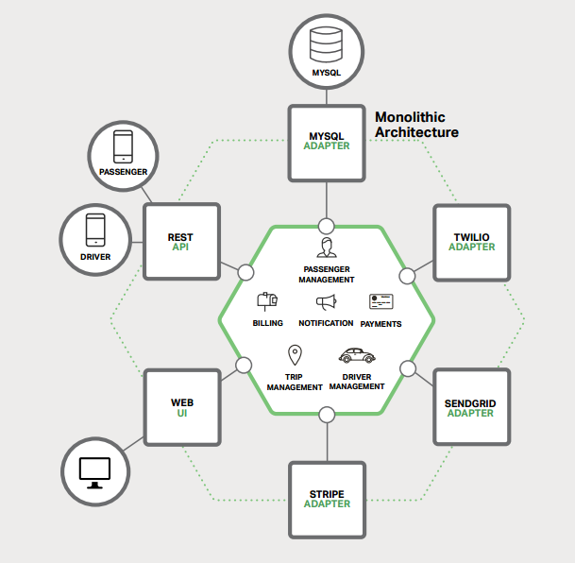
Building Monolithic Applications
Notes:
Let’s discuss this solution keeping in mind that we are trying to compete with Uber and Hailo.
At the core of the application is the business logic, which is implemented by modules that define services, domain objects, and events.
Surrounding the core are adapters that interface with the external world. Examples of adapters include database access components,
messaging components that produce and consume messages, and web components that either expose APIs or implement a UI.
Despite having a logically modular architecture, the application is packaged and deployed as a monolith.
Applications written in this style are extremely common. They are simple to develop since our IDEs and other tools are focused on building a single application.
Advantages:

Slide 32
Building Monolithic Applications
These applications are simple to test and debug.
Notes:
You can implement end-to-end testing by simply launching the application and testing the UI with a testing package such as Selenium.
Microservices are bounded by processes, physical machines, or the network itself. Debugging on a single machine/process is way easier than jumping across multiple microservices.

Slide 33
Building Monolithic Applications
These applications are simple to test and debug.
These applications are also simple to deploy.
Notes:
You just have to copy the packaged application to a server.

Slide 34
Building Monolithic Applications
These applications are simple to test and debug.
These applications are also simple to deploy.
These applications are scalable.
Notes:
You can also scale the application by running multiple copies behind a load balancer, but the load balancer itself can be a point of failure.
In the early stages of the project it works well.

Slide 35
Marching Toward Monolithic Hell
Notes:
Unfortunately, this simple approach has a huge limitation.
Successful applications have a habit of growing over time and eventually becoming huge.
During each sprint, your development team implements a few more user stories, which, of course, means adding many lines of code.
After a few years, your small, simple application will have grown into a monstrous monolith.
Common issues:

Slide 36
Marching Toward Monolithic Hell
In time the application become too complex.

Slide 37
Marching Toward Monolithic Hell
In time the application become too complex.
Being too large is very difficult for any developer to fully understand.
Notes:
As a result, fixing bugs and implementing new features correctly becomes difficult and time consuming.
What’s more, this tends to be a downwards spiral.
If the codebase is difficult to understand, then changes won’t be made correctly.
You will end up with a monstrous, incomprehensible big ball of mud(BBM).

Slide 38
Marching Toward Monolithic Hell
In time the application become too complex.
Being too large is very difficult for any developer to fully understand.
A large application is an obstacle to continuous deployment.
Notes:
Today, the state of the art for SaaS applications is to push changes into production many times a day.
This is extremely difficult to do with a complex monolith, since you must redeploy the entire application in order to update any one part of it.

Slide 39
Marching Toward Monolithic Hell
In time the application become too complex.
Being too large is very difficult for any developer to fully understand.
A large application is an obstacle to continuous deployment.
Another problem with monolithic applications is reliability.
Notes:
Because all modules are running within the same process, a bug in any module, such as a memory leak, can potentially bring down the entire process.
Moreover, since all instances of the application are identical, that bug will impact the availability of the entire application.

Slide 40
Microservices – Tackling the Complexity
Notes:
Many organizations, such as Amazon, eBay, and Netflix, have solved this problem by adopting what is now known as the Microservices Architecture pattern.
Instead of building a single monstrous, monolithic application, the idea is to split your application into set of smaller, interconnected services.
For example, a possible decomposition of the system described earlier is shown in the following picture:

Slide 41
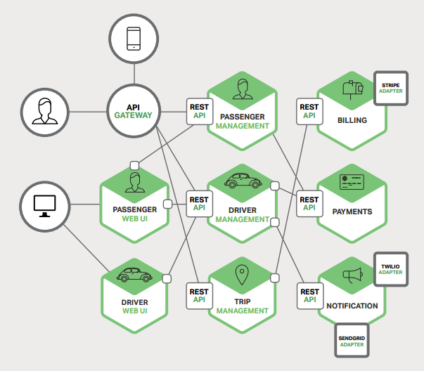
Microservices – Tackling the Complexity
Notes:
Each functional area of the application is now implemented by its own microservice.
Moreover, the web application is split into a set of simpler web applications – such as one for passengers and one for drivers, in our taxi-hailing example.
This makes it easier to deploy distinct experiences for specific users, devices, or specialized use cases.
Each backend service exposes a REST API and most services consume APIs provided by other services.
For example, Driver Management uses the Notification server to tell an available driver about a potential trip.
The UI services invoke the other services in order to render web pages.
Services might also use asynchronous, message-based communication.
Another aspect that should be mention here is the Microservices architecture pattern impact.
Scalability?

Slide 42
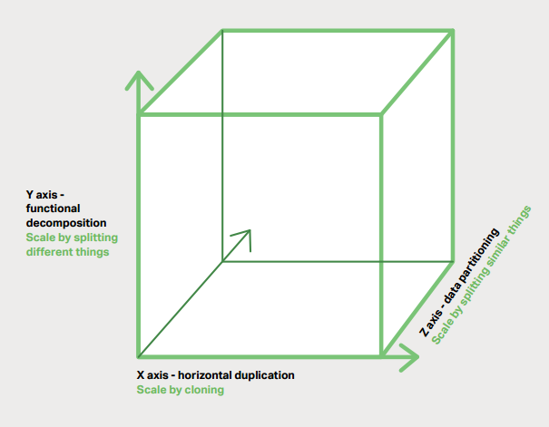
Microservices – Tackling the Complexity
Notes:
The Microservices Architecture pattern corresponds to the Y-axis scaling of the Scale Cube, which is a 3D model of scalability from the excellent book The Art of Scalability.
X-axis scaling, which consists of running multiple identical copies of the application behind a load balancer.
Z-axis scaling (or data partitioning), where an attribute of the request (for example, the primary key of a row or identity of a customer) is used to route the request to a particular server.
Y-axis scaling decomposes the application into microservices as shown in the following slide.

Slide 43
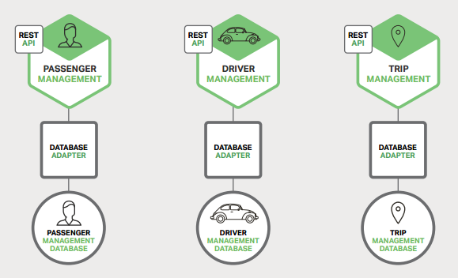
Microservices – Tackling the Complexity
Notes:
Microservices vs SOA:
Microservices used REST rather than WS-* (Web services specifications)
Microservices rejects other part of SOA => canonical schema for data access.
(In software engineering, Canonical Schema is a design pattern, applied within the service-orientation design paradigm, which aims to reduce the need for performing data model ^{[1]} transformation when services^{[2]} exchange messages that reference the same data model.^{[3]})
Microservices avoid using ESB(Enterprise service buses)

Slide 44
The Benefits of Microservices
Notes:
The Microservices Architecture pattern has a number of important benefits.

Slide 45
The Benefits of Microservices
It tackles the problem of complexity.
Notes:
It decomposes what would otherwise be a monstrous monolithic application into a set of services.

Slide 46
The Benefits of Microservices
It tackles the problem of complexity.
Enforces modularity.
Notes:
The Microservices Architecture pattern enforces a level of modularity that in practice is extremely difficult to achieve with a monolithic code base.
Consequently, individual services are much faster to develop, and much easier to understand and maintain.

Slide 47
The Benefits of Microservices
It tackles the problem of complexity.
Enforces modularity.
Enables each service to be developed independently by a team that is focused on that service.
Notes:
The developers are free to choose whatever technologies make sense, provided that the service honors the API contract.
Of course, most organizations would want to avoid complete anarchy by limiting technology options.
However, this freedom means that developers are no longer obligated to use the possibly obsolete technologies that existed at the start of a new project.
When writing a new service, they have the option of using current technology.
Moreover, since services are relatively small, it becomes more feasible to rewrite an old service using current technology.

Slide 48
The Benefits of Microservices
It tackles the problem of complexity.
Enforces modularity.
Enables each service to be developed independently by a team that is focused on that service.
Enables each microservice to be deployed independently.
Notes:
The Microservices Architecture pattern makes continuous deployment possible.

Slide 49
The Benefits of Microservices
It tackles the problem of complexity.
Enforces modularity.
Enables each service to be developed independently by a team that is focused on that service.
Enables each microservice to be deployed independently.
Enables each service to be scaled independently.
Notes:
You can deploy just the number of instances of each service that satisfy its capacity and availability constraints.

Slide 50
The Drawbacks of Microservices
Notes:
As Fred Brooks wrote almost 30 years ago, in The Mythical Man-Month, there are no silver bullets.

Slide 51
The Drawbacks of Microservices
The name itself.
Notes:
The term microservice places excessive emphasis on service size. In fact, there are some developers who advocate for building extremely fine-grained 10-100 LOC services.
While small services are preferable, it’s important to remember that small services are a means to an end, and not the primary goal.
The goal of microservices is to sufficiently decompose the application in order to facilitate agile application development and deployment.

Slide 52
The Drawbacks of Microservices
The name itself.
The complexity that arises from the fact that a microservices application is a distributed system.
Notes:
Developers need to choose and implement an inter-process communication mechanism based on either messaging or RPC.

Slide 53
The Drawbacks of Microservices
The name itself.
The complexity that arises from the fact that a microservices application is a distributed system.
The partitioned database architecture.
Notes:
Business transactions that update multiple business entities are fairly common.
These kinds of transactions are trivial to implement in a monolithic application because there is a single database.
In a microservices-based application, however, you need to update multiple databases owned by different services.
Using distributed transactions is usually not an option, and not only because of the CAP theorem.
They simply are not supported by many of today’s highly scalable NoSQL databases and messaging brokers.
You end up having to use an eventual consistency-based approach, which is more challenging for developers.

Slide 54
The Drawbacks of Microservices
The name itself.
The complexity that arises from the fact that a microservices application is a distributed system.
The partitioned database architecture.
Testing is also much more complex.
Notes:
In contrast, a similar test class for a service would need to launch that service and any services that it depends upon, or at least configure stubs for those services.
Once again, this is not rocket science, but it’s important to not underestimate the complexity of doing this.

Slide 55
The Drawbacks of Microservices
The name itself.
The complexity that arises from the fact that a microservices application is a distributed system.
The partitioned database architecture.
Testing is also much more complex.
Deploying a microservices-based application is also much more complex.
Notes:
A monolithic application is simply deployed on a set of identical servers behind a traditional load balancer.
Each application instance is configured with the locations (host and ports) of infrastructure services such as the database and a message broker.
In contrast, a microservice application typically consists of a large number of services.
For example, Hailo has 160 different services and Netflix has more than 600, according to Adrian Cockcroft.
Amazon has thousands.☺

Slide 56
Why Microservices?
Notes:
TO DO => add explanations

Slide 57
Why Microservices?
Gilt: “From Monolith Ruby App to Distributed Scala Micro-Services” (NYC Tech Talks) [Link]
Nike: “Nike’s Journey to Microservices” (AWS Re:Invent 2014) [Link]
SoundCloud: ”Building Products at SoundCloud - Part III: Microservices in Scala and Finagle” [Link]
Capital One: “Lack Of Legacy Lets Capital One Build Nimble Infrastructure” [Link]
Hailo: “A Journey into Microservices” [Link]
Autoscout24: “Why Autoscout24 changes its technology” [Link]
Zalando: “From Monolith to Microservices” [Link]

Slide 58
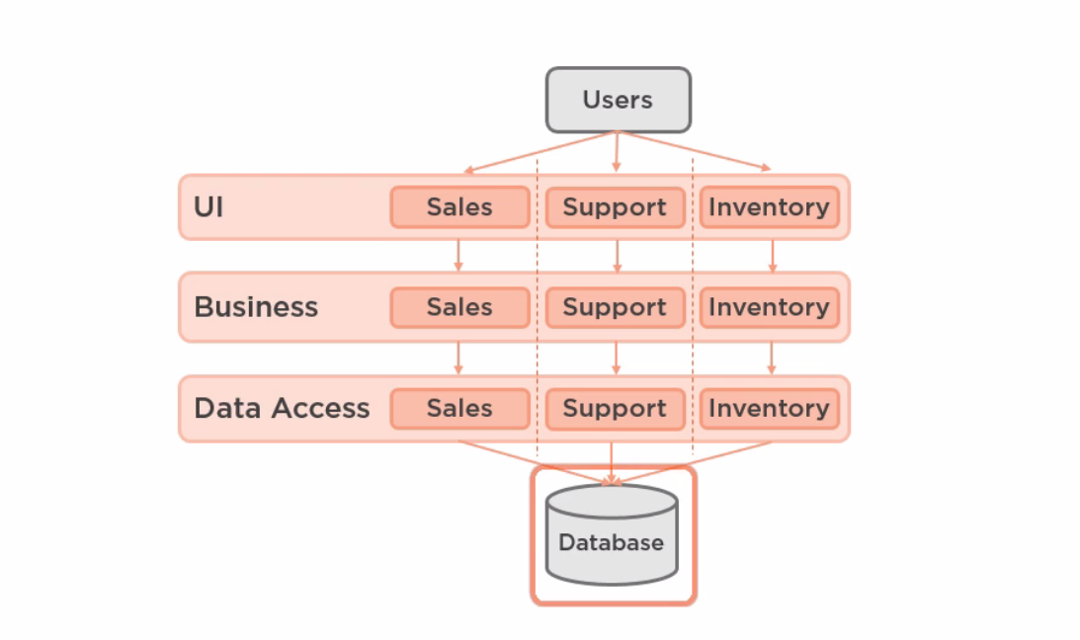
Why Microservices?
Notes:
Let’s start from the following sample: Everything module (sales/support/Inventory is stored into a single database).
Let’s presume that we are building an application that perform: Sales and Support tasks.
Our problem domain might look like:

Slide 59

Why Microservices?
Notes:
In the old days we would been model this like in the following image:

Slide 60
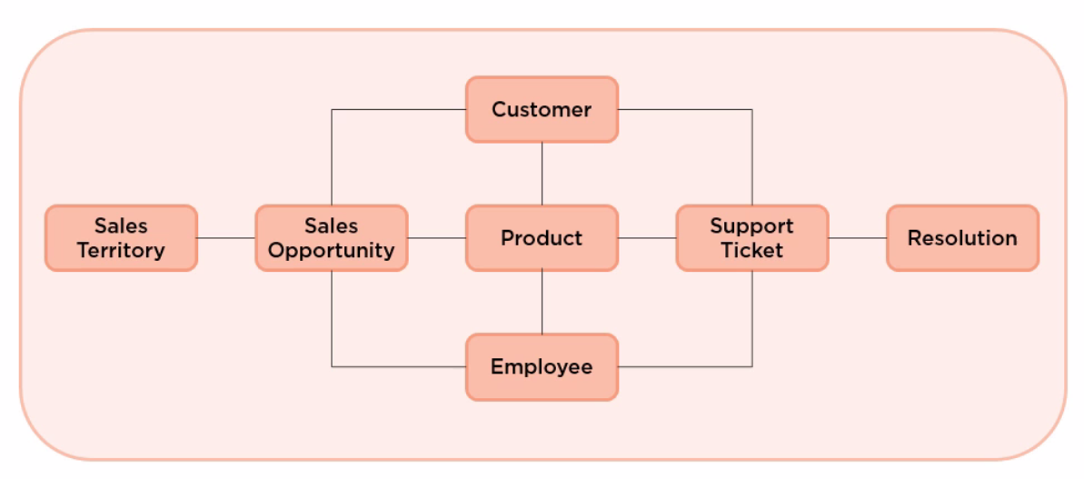
Why Microservices?
Notes:
This is a single unified domain model.
Sample:
Product is a “product” in the sales side or in the support side.
Contact is a Contact in sales side but a customer in Support side.(we will model this with nullable fields).
Employee is a Sale person in Sales side and a Support Person in Support side.
Problem appear when we will try to identify contexts like in the following image:

Slide 61
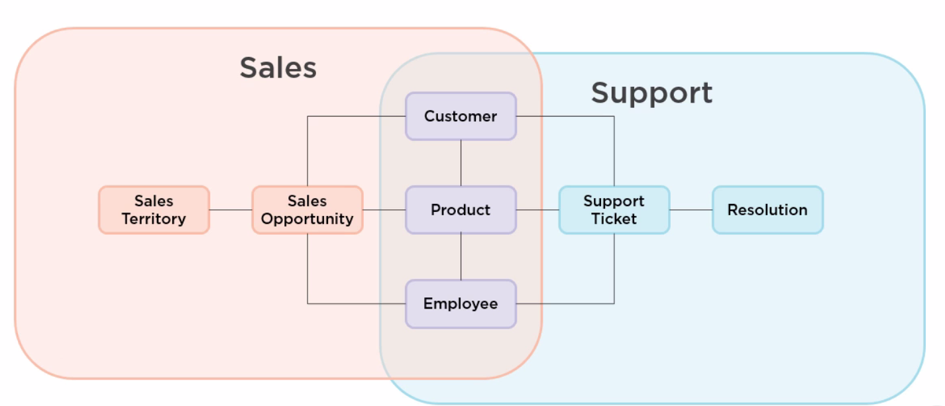
Why Microservices?
Notes:
Customer, product and Employee contains properties and validation that are applicable into a context but not in the other.

Slide 62
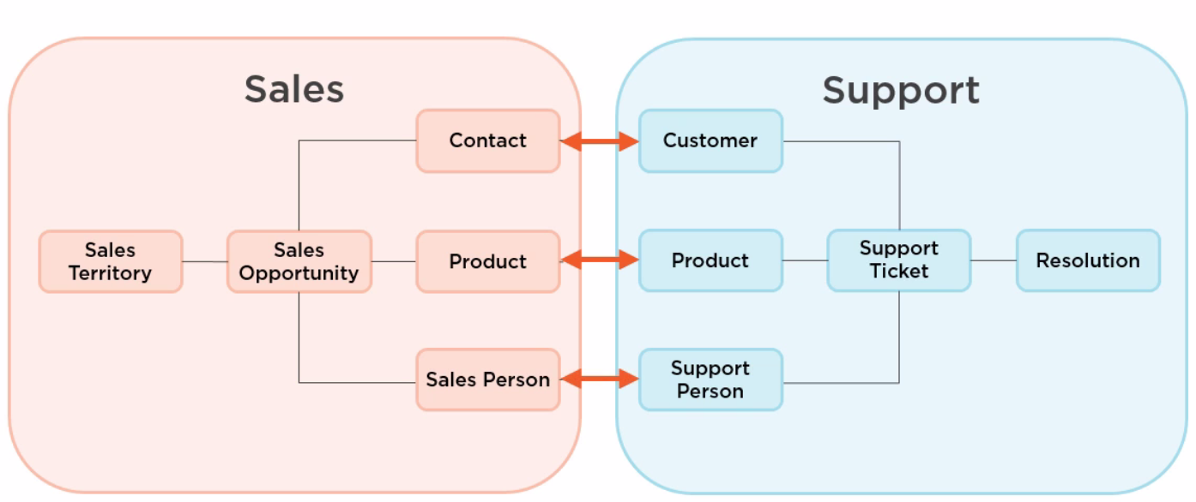
Why Microservices?
Notes:
Those are bounded context in DDD.
In order to have consistency we will use interfaces and coordinated transactions.
These leads us to microservices.

Slide 63
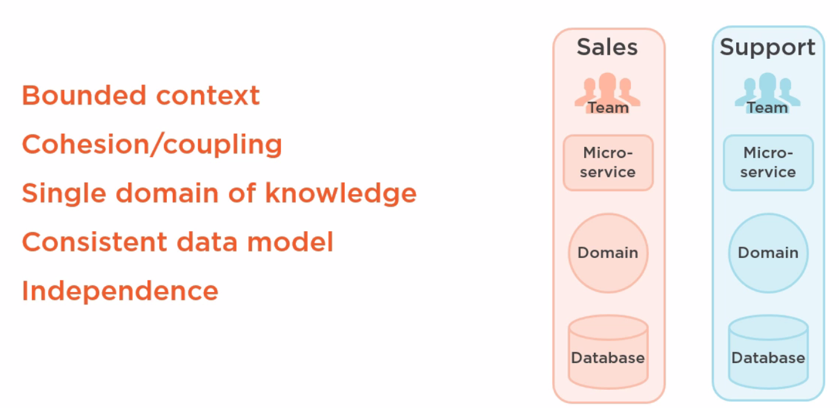
Why Microservices?
Notes:
Independence: different technologies for instance.

Slide 64
demo

Slide 65
About Centric Internship
Notes:
3 months payed internship
Possibility to work in Scrum teams
Scrum training
Security training
Intensive courses/workshops (Object oriented design, Automated testing, ORM’s, API’s, Architectural patterns, Best practices, Mobile ready development/Angular 2/4 etc)

Slide 66
One more thing …

Slide 67
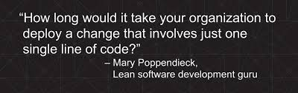
One more thing …

Slide 68
SUMMARY

Slide 69
SUMMARY
Building complex applications is not an easy task.

Slide 70
SUMMARY
Building complex applications is not an easy task.
The Monolithic Architecture pattern only makes sense for simple, lightweight applications.

Slide 71
SUMMARY
Building complex applications is not an easy task.
The Monolithic Architecture pattern only makes sense for simple, lightweight applications.
The Microservices Architecture pattern is the better choice for complex, evolving applications, despite the drawbacks and implementation challenges.

Slide 72
SUMMARY
Building complex applications is not an easy task.
The Monolithic Architecture pattern only makes sense for simple, lightweight applications.
The Microservices Architecture pattern is the better choice for complex, evolving applications, despite the drawbacks and implementation challenges.
Probably the best way to define boundaries for microservices is by using Bounded Context from DDD (Domain Driven Design)

Slide 73
bibliography

Slide 74
bibliography
Alagarasan, Vijay. “Seven Microservices Anti-patterns”, August 24, 2015.
Cockcroft, Adrian. “State of the Art in Microservices”, December 4, 2014.
Fowler, Martin. “Microservice Prerequisites”, August 28, 2014.
Fowler, Martin. “Microservice Tradeoffs”, July 1, 2015.
Humble, Jez. “Four Principles of Low-Risk Software Release”, February 16, 2012.
Humble, Jez, Chris Read, and Dan North. “The Deployment Production Line”. In Proceedings of the conference on AGILE 2006, 113– 118.
IEEE Computer Society. Kniberg, Henrik, and Anders Ivarsson. “Scaling Agile at Spotify”, October 2012.
http://microservices.io/patterns/microservices.html

Slide 75

Bibliography

Slide 76


BIBLIOGRAPHY

Slide 77
Questions?

Slide 78
Thank you!
dan.nastasa@centric.eu
florin.olariu@centric.eu

